Slide 1
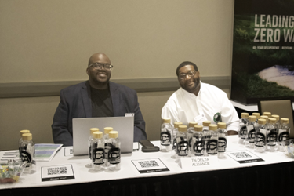
TRC Board of Directors Information Become a leader. Make a Difference.

Slide 2
Welcome to the TRC Board of Directors
Congratulations on being voted onto the board of an organization with over 35 years of service!
We look forward to working and serving together to raise recycling as the standard in Tennessee.
TRC’s Mission:
Our mission is dedicated to promoting recycling and sustainable materials management practices in the State of Tennessee. We are a 501(c)3 non-profit organization.
Who is involved with TRC?
We are a coalition of many industries, companies, and individuals networked together to raising recycling as the standard in Tennessee.

Slide 3
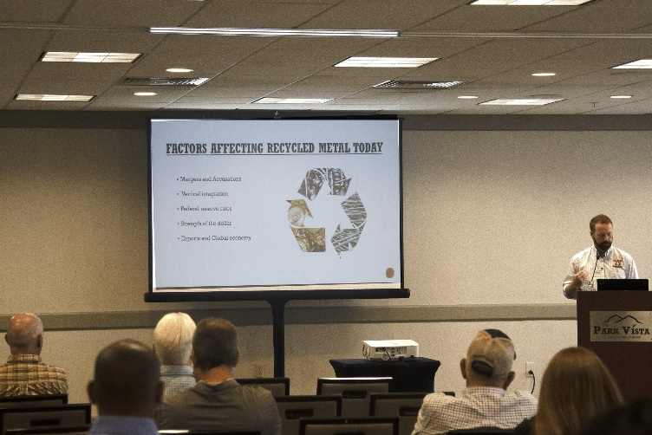
What are some of TRC’s main views on recycling?
Recycled materials have value and contribute to the economic well-being of all Tennesseans.
Recycling promotes and sustains jobs adds to the revenue of local governments by growing the tax base and through the sale of collected commodities.
Recycling enhances the personal wealth of all Tennesseans through cost avoidance of landfill tipping fee charges.
Ultimately, it also protects the environment by keeping the materials out of the landfill.
Who does TRC work with around the state?
We partner with local, state, and federal governments as well as private business and industry stakeholders to provide resources, education, and outreach for our recycling message.
We strongly support the manufacturing industries in Tennessee since recyclables serve as a high- quality feedstock that fuels their manufacturing process.
We want to be the group that people think of when recycling and Tennessee come to mind!

Slide 4
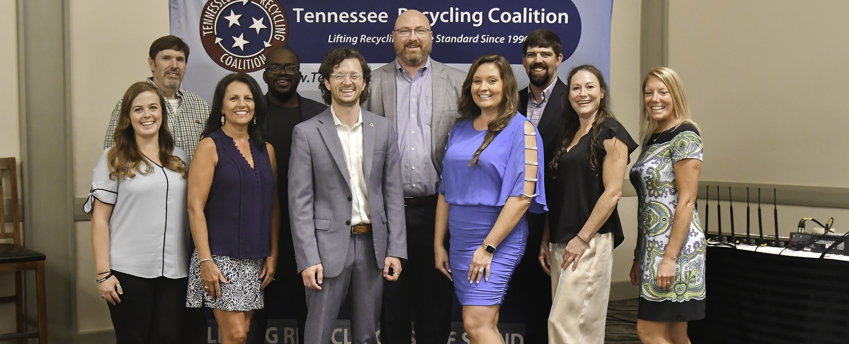
What is expected of me as a TRC board member?
TRC is a volunteer-run board, meaning that everyone on the board is donating their time to the organization’s mission. It is up to the board to keep TRC moving forward and advancing recycling in Tennessee.
Your involvement on the board is critical in keeping the organization running smoothly and effectively.
Workshops, TNSC conferences, scholarships, and recycling grants are a few activities you will help with.
Requirements are the Board retreat, monthly calls, and the TNSC Conference.

Slide 5
What are some benefits to serving on this board?
Growing recycling in Tennessee. You can be involved with an organization that can have a state-wide reach in driving more sustainable recycling participation.
Leadership development. You will have the chance to work on important committees that will leverage your talents and skills to keep TRC moving forward with our mission.
Networking. Meet new faces from around the state who have an interest in actively leading and effectively improving the recycling landscape in Tennessee.
Expanding your skill set. You will develop new skills to interface with governments, industry, private business, and down to individuals to strengthen TRC’s reach and focus for recycling improvements around the state.

Slide 6
2024-2025 Current Officers
& Executive Director of TRC
TRC President: Caleb Powell
TNSC Conference Director: Lincoln Young
Secretary: Lindsay Ross
Executive Director: Amber Greene
Treasurer: open

Slide 7
What should I expect at TRC board meetings?
The board meetings are meant to report on activities and updates from the committees and discuss any pressing matters that affect the board as a whole once a month on teams.
Participation of a board member via phone shall constitute presence in person at a meeting.
From the bylaws: A majority of the seated Board of Directors present or providing proxy shall constitute a quorum. No Business of the Coalition or resolutions may be enacted or passed without a quorum present.

Slide 8
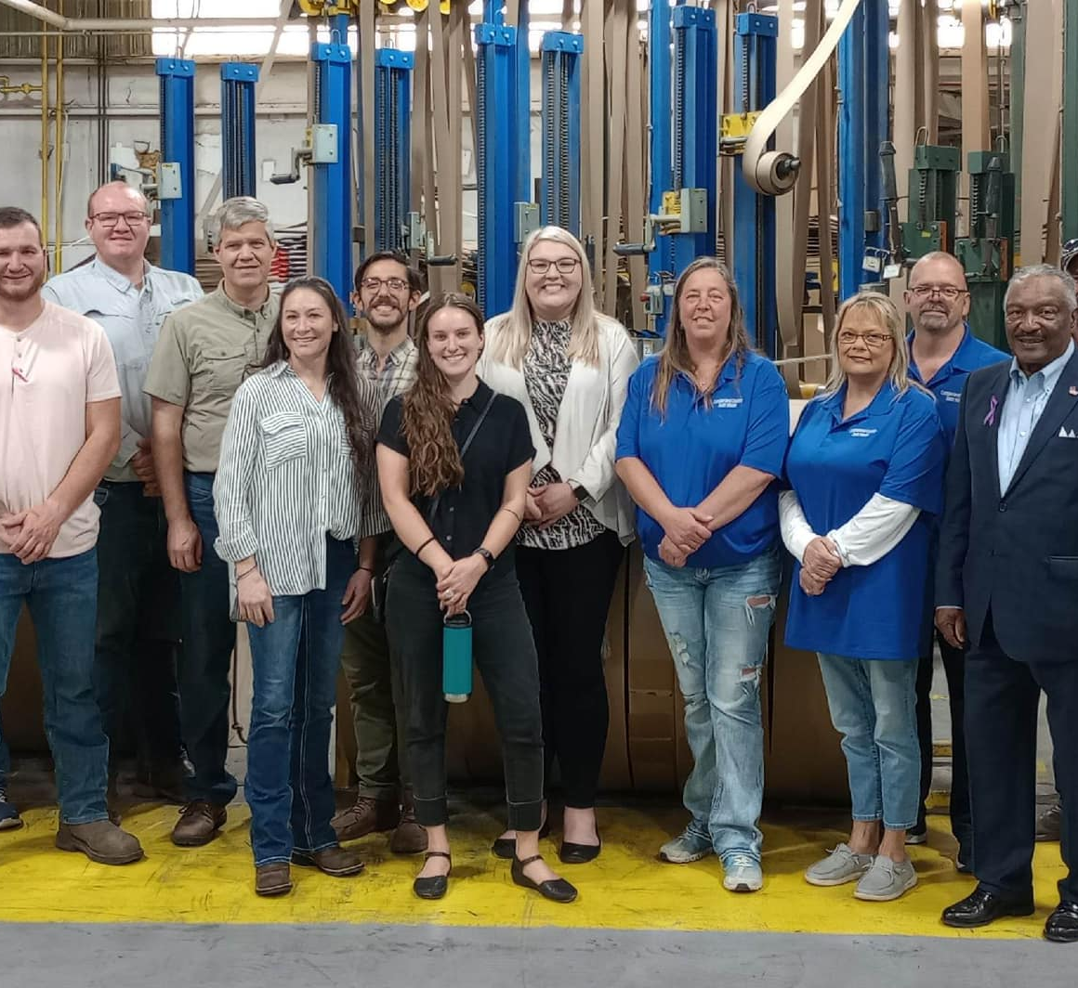
Workshops
2023 Sonoco Workshop

Slide 9
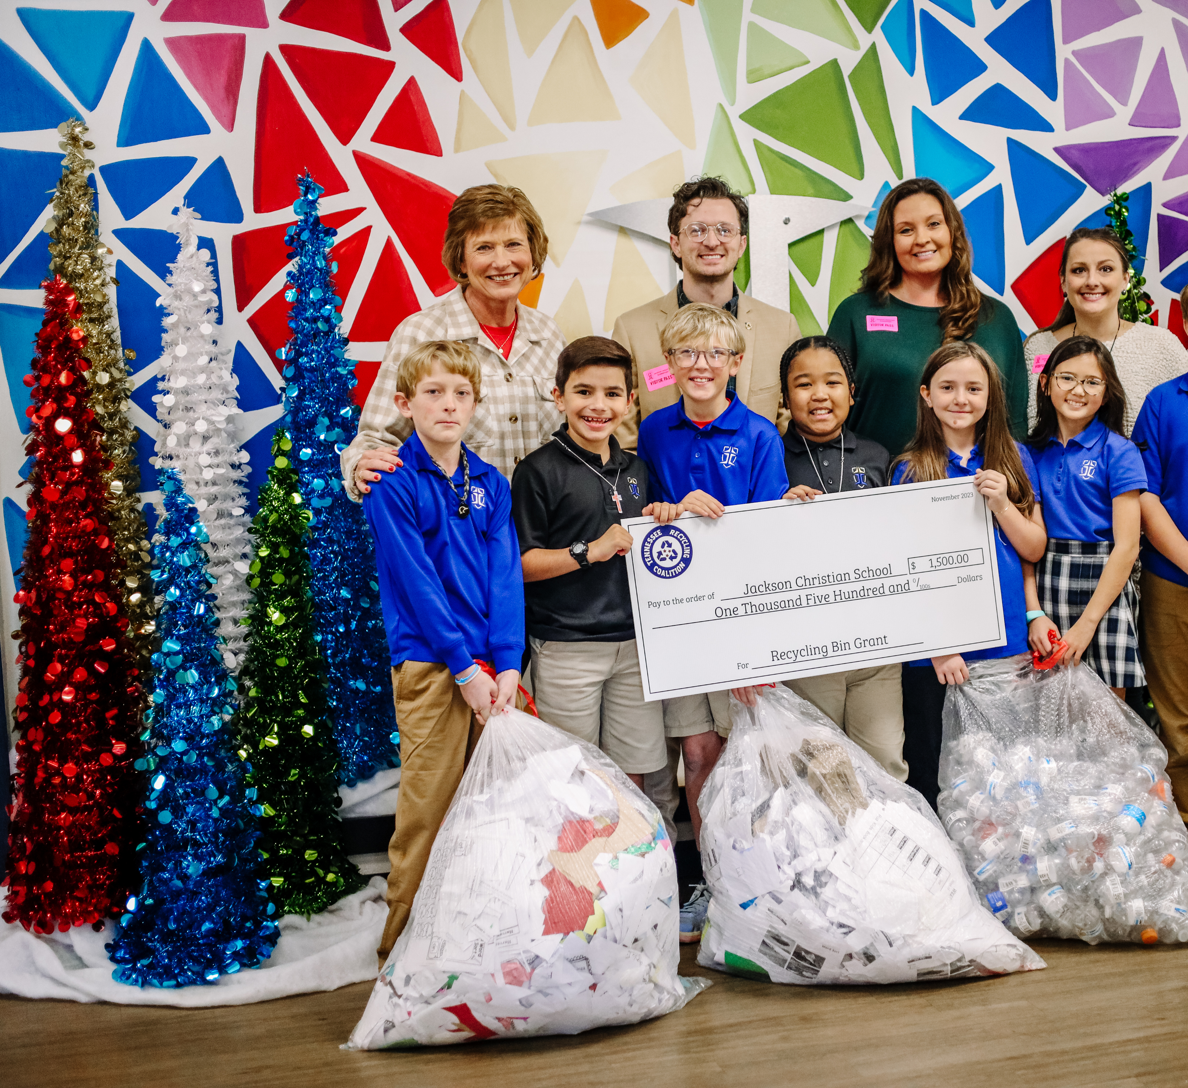
Fall Recycling Grant Recipients

Slide 10
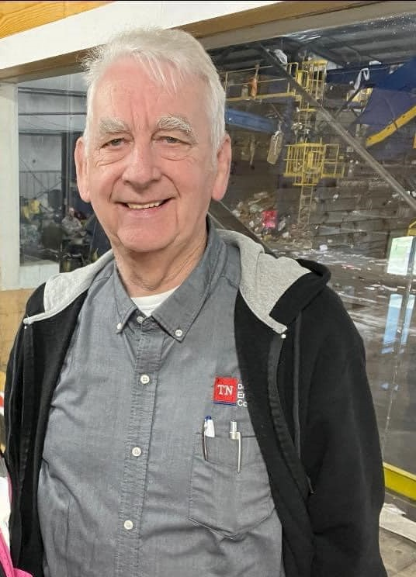
Bob Fletcher Memorial Scholarship
The Tennessee Recycling Coalition is honored to announce the Bob Fletcher Memorial Scholarship which honors the late Mr. Bob Fletcher who worked for the Tennessee Department of Environment & Conservation. He was a passionate advocate helping counties, cities, and businesses with household hazardous waste, recycling, and other environmental issues.
The Tennessee Recycling Coalition is proud to continue his legacy by providing an opportunity for the next generation of environmental leaders who are pursuing careers in the environmental field and will offer a $2,500 scholarship to one high school senior or first-year college student. The student must be a senior in high school attending college or a first-year college student.

Slide 11
2024 New Board Members
Tom Brandon- WM
Mark Torbett- Sullivan County Solid Waste
Monica Kizer- Keep TN Beautiful

Slide 12
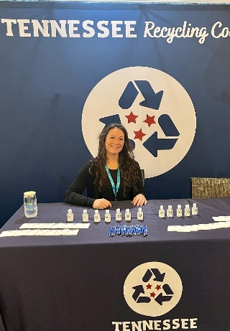
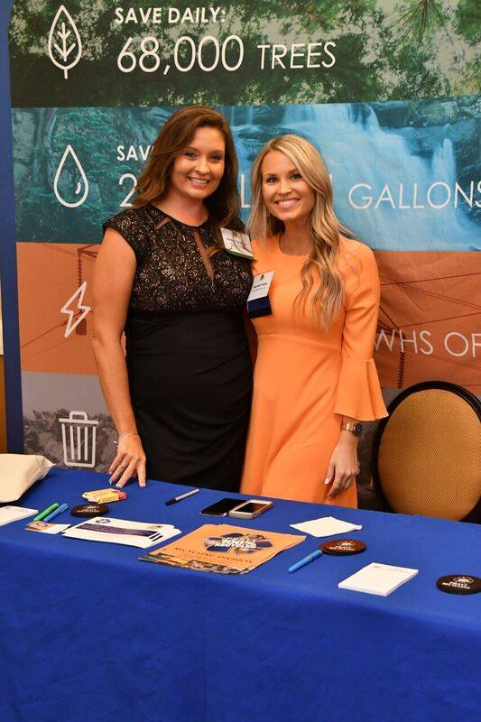
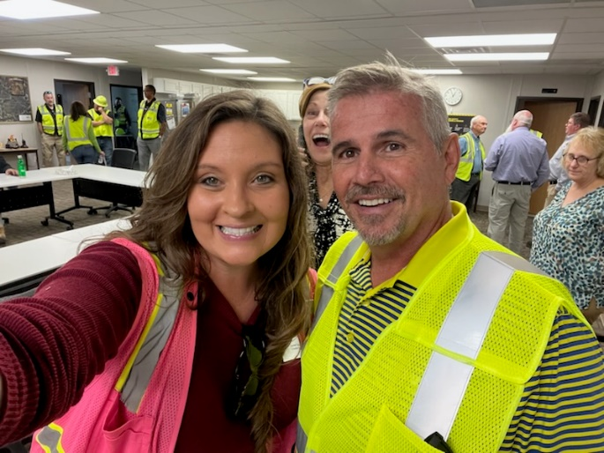
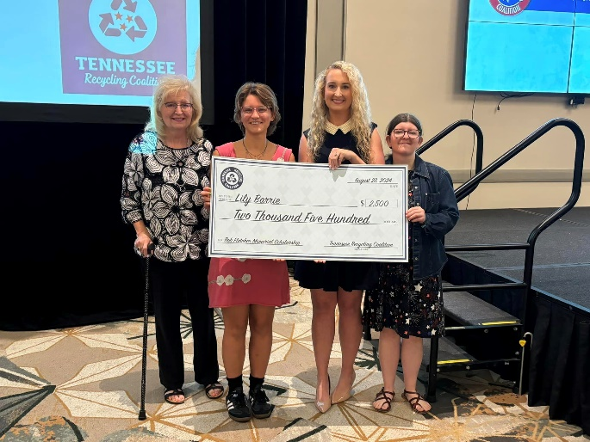
Thank you
We look forward to working with you !!

